Slide 1

Drupal 8
Presented by: Karthiselvam Seeralan
Date: 07-02-2014

Slide 2

Agenda
Main Intention of Drupal 8
Newly added modules list in Core
Remove modules list from Core
Custom module creation
Theming creation
Question Section
Notes:
Project Metrics, provide metrics analysis, deviations of metrics from goals to be discussed
Issues includes, both technical and non-technical, please ensure that all issues are discussed in the SMR

Slide 3



Main Intention of Drupal 8
Client & End user
  1. Authoring Expiring Improvements
  contextual link
  wysiwyg editor
  2. Mobile Improvement
  Responsesive themes, Images and breakpoints
  Mobile friendly administration
  Responsive preview bar
  Mobile first layout
  Site Builders
  1. Add New Field
  Entity reference Field
  Data field
  Link, and Email
  2. Customizes the Look and feel of data entry form
  3. View in Core

Slide 4


Main Intention of Drupal 8
4.Multilingual Improvements
  Community translation download
  Designer and Themers
  1. HTML5
  2. Twig Template instead of PHP Template field
  3. Dropped support for IE6 & IE7 (and most of 8)
  Developer
  1. Configuration Management System
  2. Web Services
  3. Symphony Framework
  4. OOPs
  5. Latest PHP Standards(namespace)
  6. External libraries: PHPUnit, Zend Feed Component &Composer
  7. YMAL: Yet Another Markup Language

Slide 5

Newly added modules list in Core
Action
Ban
Breakpoint, Layout
Datetime
Email, Telephone & Link
Editor
Entity, Entity reference
Views, Views UI
Translation Entity
Hal
History, Tour
Menu Link
REST, Serialization, XMLRPC
Reference URL : https://drupal.org/node/1283408

Slide 6

Removed modules list from Core
Blog module
Dashboard module
Garland theme
PHP filter module
Profile module
Trigger module
Poll module
Overlay module
OpenID module
Reference URL: https://drupal.org/node/2116417

Slide 7
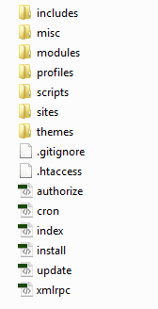
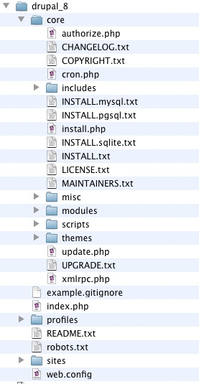
Folder structure
Drupal 7 Vs 8 root folder structure

Slide 8
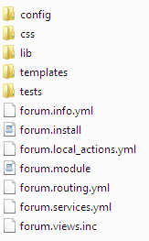

Custom module creation
Custom module folder structure
Create the custom module folder Path “modules/custom/module_name”.

Slide 9
Custom module creation
Create .info.yml "info yaml file" file. Yaml: “Yet another markup language”
name: Example Module
description: 'Example Module description.'
package: Custom
type: module
version: 1.0
core: 8.x
dependencies:
- node
configure: example.admin_index
Create module_name.routing.yml file
page_example_simple:
path: 'examples/page_example/simple'
defaults:
_content: '\Drupal\page_example\Controller\PageExampleController::simple'
requirements:
_permission: 'access simple page'

Slide 10
Custom module creation
Create Controller file
  Path: “modules/custom/module_namelib/Drupal/module_name/Controller/”
  For Example:
  namespace Drupal\page_example\Controller;
  use Symfony\Component\HttpKernel\Exception\AccessDeniedHttpException;
  class PageExampleController {
  public function simple() { return array( '#markup' => '<p>' . t(‘Welcome to Drupal 8.') . '</p>', ); }
  }

Slide 11
Custom module creation
Defining own configuration
path: “modules/example/config/”
example.settings.yml – example is a name of the module.
        block: active:
        limit: '5' new:
        limit: '5‘
        topics: hot_there
        shold: '15'
        order: '1'
        page_limit: '25‘
        vocabulary: forums
        Reference URL: https://drupal.org/node/2116781

Slide 12

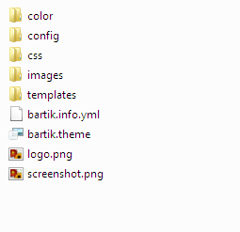
Theming creation
About Twig template
Fast: Twig compiles templates down to plain optimized PHP code.
The overhead compared to regular PHP code was reduced to the very minimum.
Secure: Twig has a sandbox mode to evaluate untrusted template code.
This allows Twig to be used as a template language for applications where users may modify the template design.
Flexible: Twig is powered by a flexible lexer and parser. This allows the developer to define its own custom tags and filters, and create its own DSL.
Theme Folder structure
Theme Folder structure

Slide 13
Theming creation
Twig theming
  'compiled' PHP template
  Stored template files in following folder
  Folder path: sites/default/files/php_storage/
How to create the Twig template file
Create template files in following path
Path: core\themes\bartik\templates
Coding standard in Twig template.
  File names
node--article.html.twig instead of file node--article.tpl.php
  Comment line {# …. #}
{#
/**
* @file
* File description
*/
#}

Slide 14
Theming creation
Variables
  Printing a variable:
  PHPTemplate: <div class="content"><?php print $content; ?></div>
  Twig: <div class="content">{{ content }}</div>
  Printing a hash key item
  PHPTemplate: <?php print $item['#item']['alt']; ?>
  Twig: {{ item['#item'].alt }}
  Assigning a variable:
  PHPTemplate: <?php $custom_var = $content->comments; ?>
  Twig: {% set custom_var = content.comments %}
  Assigning an array:
  PHPTemplate: <?php $args = array('!author' => $author, '!date' => $created); ?>
  Twig: {% set args = {'!author': author, '!date': created} %}
Conditionals
  PHPTemplate: <?php if ($content->comments): endif; ?>
  Twig: {% if content.comments %} {% endif %}
  PHPTemplate: <?php if (!empty($content->comments)): endif; ?>
  Twig: {% if content.comments is not empty %} {% endif %}
  PHPTemplate: <?php if (isset($content->comments)): endif; ?>
  Twig: {% if content.comments is defined %} {% endif %}
  PHPTemplate: <?php if ($count > 0): endif; ?>
  Twig: {% if count > 0 %} {% endif %}

Slide 15
Theming creation
Control structures
PHPTemplate: <?php foreach ($users as $user) {} ?>
Twig: {% for user in users %} {% endfor %}
6. Filters
  Check_plain:
  PHPTemplate: <?php print check_plain($title); ?>
  Twig: {{ title|striptags }}
  Translate:
  PHPTemplate: <?php print t('Home'); ?>
  Twig: {{ 'Home'|t }}
  Translate with substitutions:
  PHPTemplate: <?php print t('Welcome, @username', array('@username' => $user->name)); ?>
  Twig: {{ 'Welcome, @username'|t({ '@username': user.name }) }}
  Drupal 8 Twig (with trans tag extension):
  {% set username = user.name %}
  {% trans %}
  Welcome, {{ username }}
  {% endtrans %}

Slide 16
Theming creation
  Implode a list:
  PHPTemplate: <?php echo implode(', ', $usernames); ?>
  Original Twig: {{ usernames | join(', ') }}
  Drupal 8 Twig¹: {{ usernames }}
  Escape:
  PHPTemplate: <?php echo check_plain($title); ?>
  Original Twig: {{ title|e }}
  Drupal 8 Twig²: {{ title }}
Whitespace control
  <div class="body">
  {{- block.content -}}
  </div>

Slide 17

Question & Answer

Slide 18

Notes:
18

